Slide 1
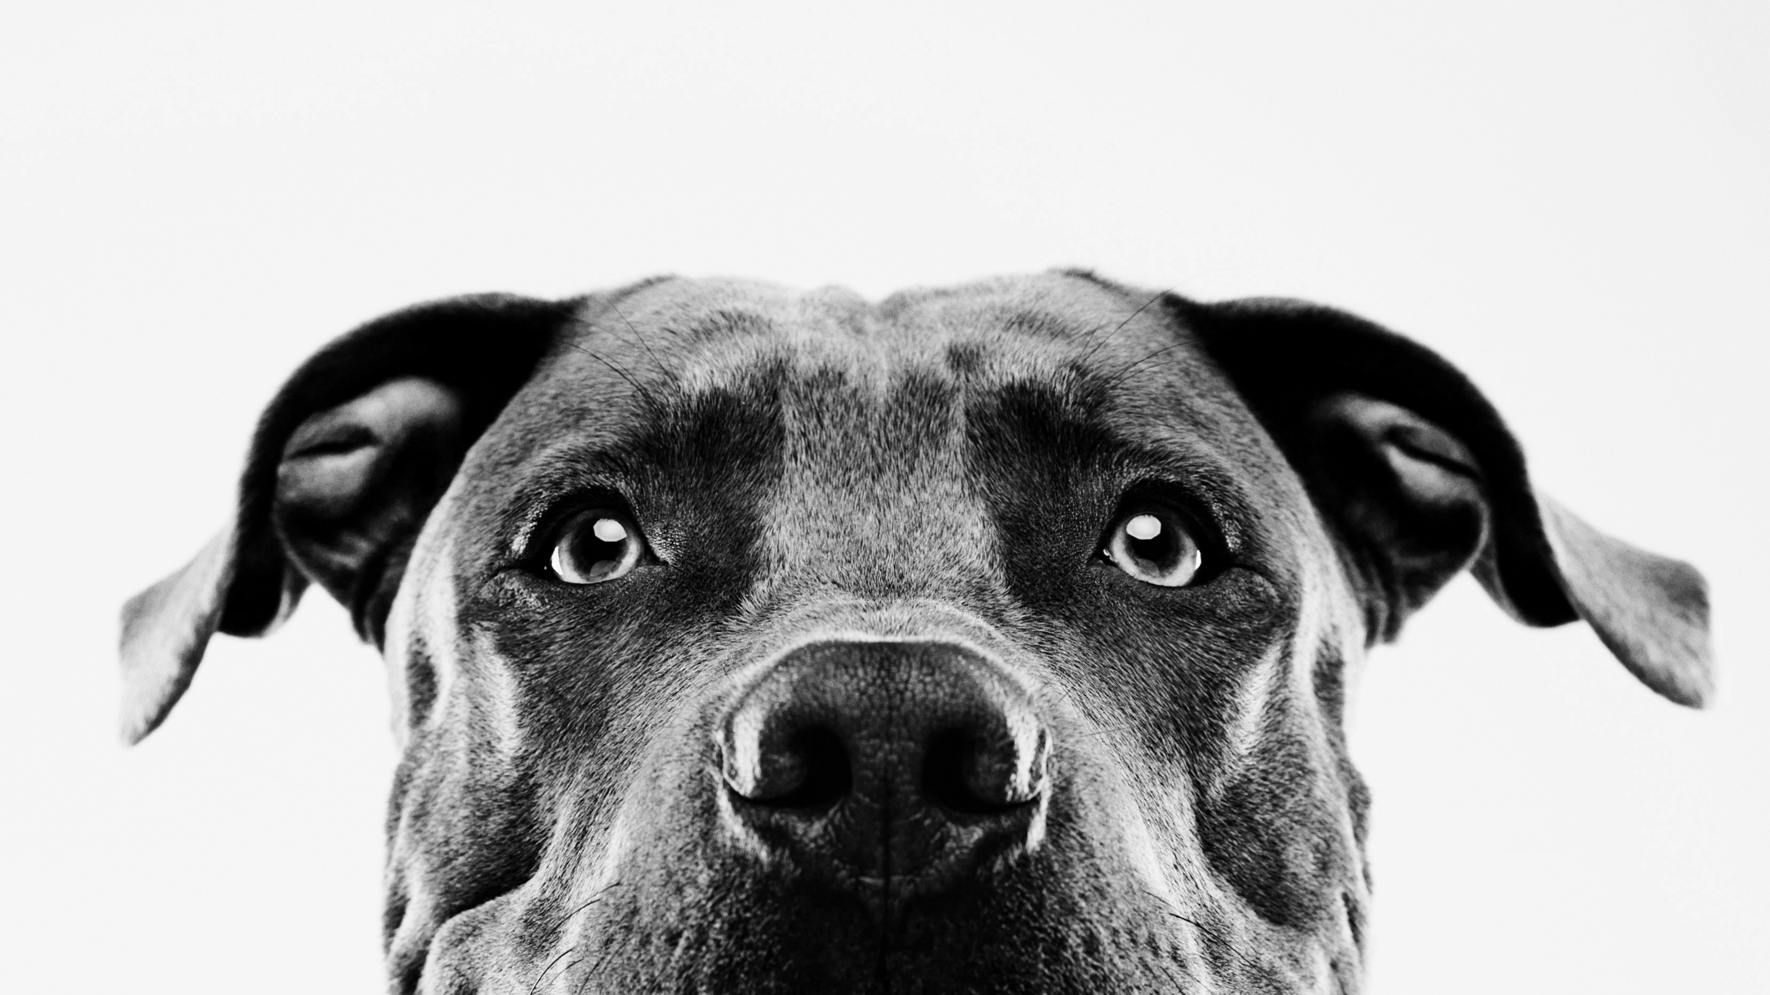
Austin Animal Center Decision Support system
Justin Frazier and Katie thornton

Slide 2
Overview
Business need
Key performance indicators with results
Interpretations & results

Slide 3
business need
Animal shelters are often underfunded and rely heavily on donations and volunteer support. A Decision Support System can help improve animal welfare by enabling better management of:
Capacity & Overcrowding – Forecast periods where intakes exceed outcomes to prepare in advance, reduce stress, and avoid overcrowding
Staffing & Volunteer Hours – Schedule and allocate staff/volunteers based on forecasted demand
Supplies & Budget – Allocate funds and donations more efficiently, and collaborate with other shelters to meet needs
Impactful Marketing – Identify breeds with the highest/lowest adoption rates and highest euthanasia risk and market accordingly
Owner Returns – Identify breeds least likely to be reclaimed and focus outreach on those most at risk

Slide 4
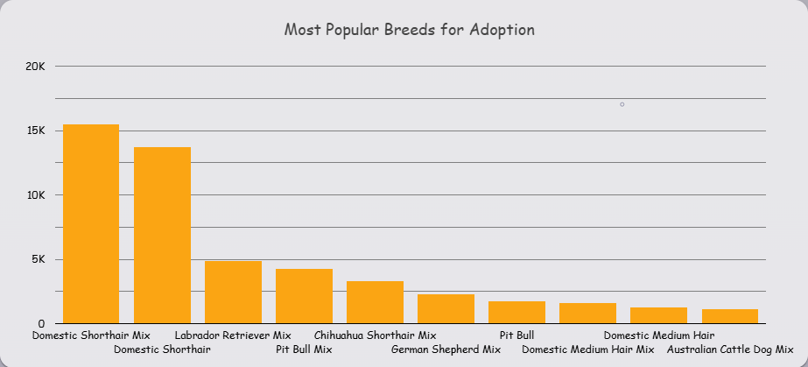
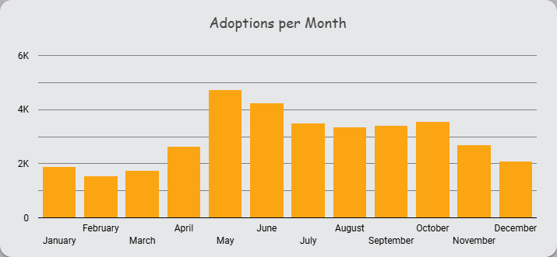
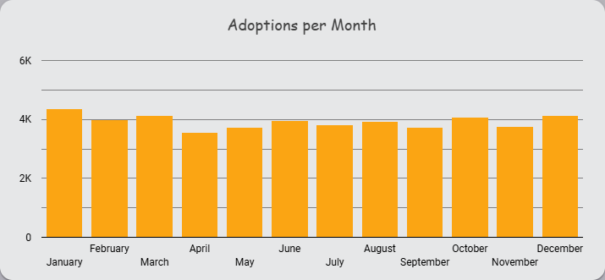
Adoption rate
Under 75% threshold at 48.75%
Past 4 Years: 59.48%
Dogs have more total adoptions but a slightly lower adoption rate
Cats have less adoptions but a slightly higher adoption rate
Shorthair cats are the most popular, with a drastic decrease in medium to long hair
Increase marketing in these areas
Cats
Dogs

Slide 5
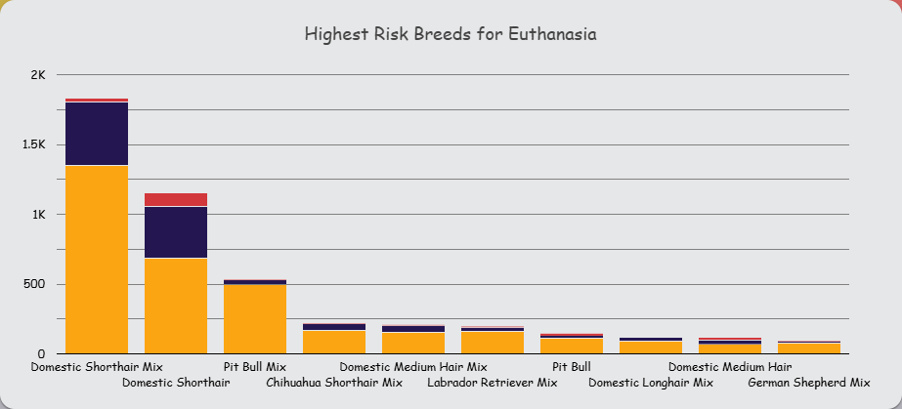
Euthanasia Rate
Under 10% threshold at 6.22%
Decreased in past 4 years to ~ 5%
Shorthair cats are the most likely to be euthanized
Almost exclusively due to the animal suffering
27% of dogs overall are euthanized due to aggressiveness
Pit Bull Mixes are the highest risk for euthanasia amongst dogs
48% are euthanized due to aggressiveness
Train staff and coach community on how to manage dogs to mitigate aggressiveness
Focus efforts on Travis, Austin, and Mustang Ridge where strays are more likely to be found injured

Slide 6
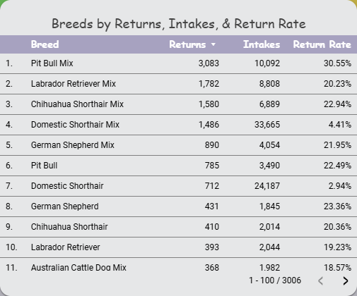
Average Rate of Return
Underperforming benchmark of 25% at just under 15% on average
This average has been decreasing the past 4 years going from 10% to 7%
Almost 25% of dogs taken in by the shelter get returned to their owner
17% of livestock make it back to their original owners
Only 4% of cats get returned to their owner
More emphasis needs to be placed on finding the owners to lost cats

Slide 7
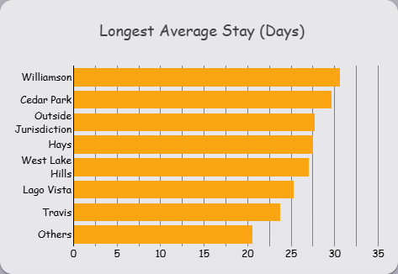
Average Length of stay
Over double benchmark of 10 days
Williamson & Cedar Park have longest averages at over 30 days
Mostly due to a few animals with very long stays
Cedar Park has had chihuahua, scrappers, there for over 450 days
Shelter can implement policy that fosters animals over a certain threshold
Focus marketing efforts on dogs with long stays as they stay longest

Slide 8
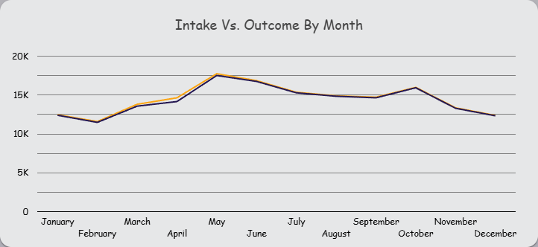
Intake vs Outcome Balance
Around benchmark of 1.00
Overall, Intake Vs Outcome balance is very consistent
Generally skews more towards intakes
Intakes start increasing from February to May
Majority of intakes are cats
Additional resources and staffing should be made to deal with the extra cats expected during this time

Slide 9

Thank you

